Slide 1

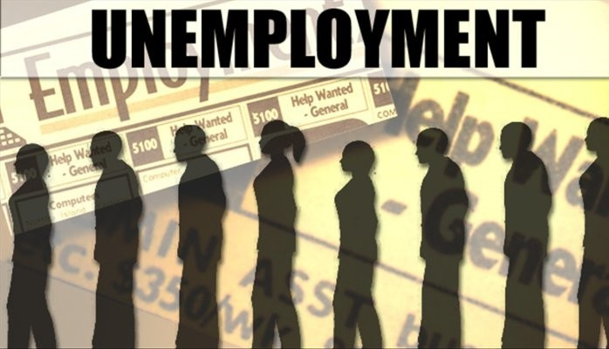
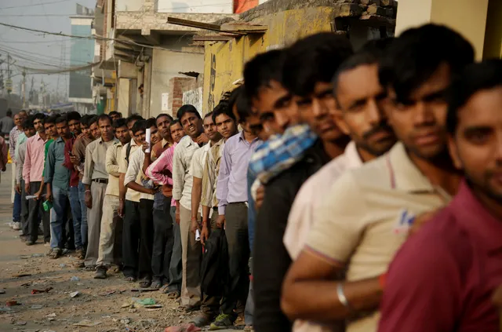
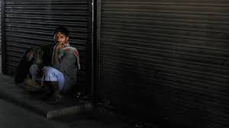
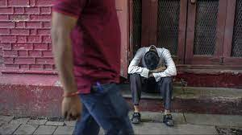

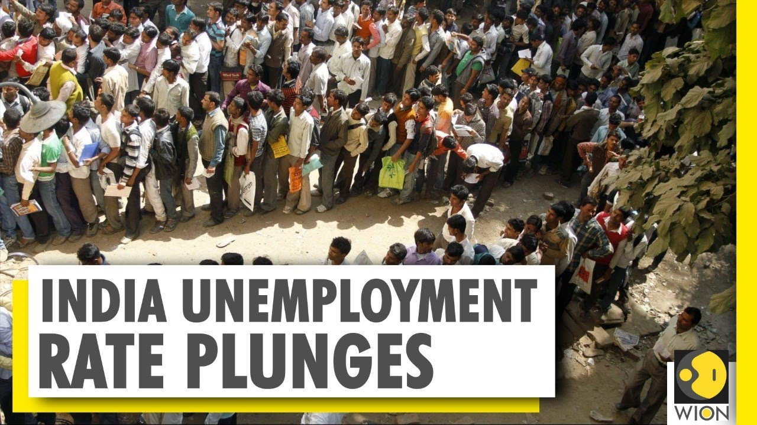
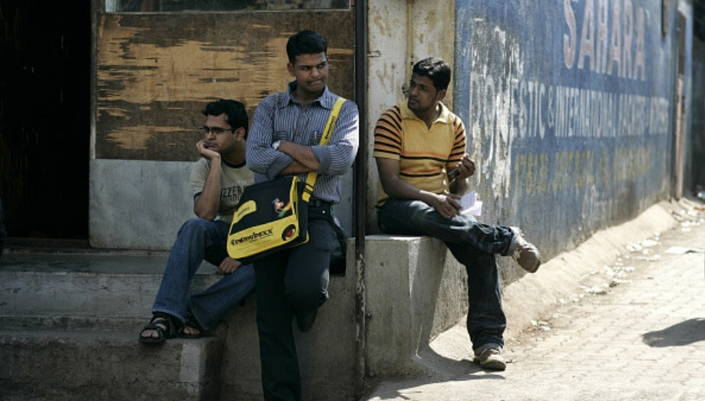
Change in Employment Number
- An impact of Covid-19 Pandemic
An Excel - research project analysis by Anushka Banerjee

Slide 2

Table of Content
Dataset Review
Objective
Discussion
Insights

Slide 3

Dataset Review
The dataset under review is sourced from Kaggle and focuses on unemployment statistics and it comprises of 5920 records.
It encompasses a mix of numerical and categorical variables, capturing diverse dimensions of unemployment data.
Fields include information on demographic factors, employment sectors, geographic locations, and specific unemployment metrics like Year, Region, Estimated Employment and Unemployment Rate along with Estimated Labor Participation Rate and Area, namely Urban and Rural.
The dataset appears relatively clean, with no missing values.
While the data covers very small-scale timeframe, therefore some limitations must be considered.
Researchers and policymakers can leverage this dataset to analyze the impact of economic policies on unemployment rates.

Slide 4
OBJECTIVES
01
02
03
04
Yearly Trend: Understanding the fluctuations in
Labor Force Participation
and Estimated Employment rate over time and
across regions is crucial
for assessing economic trends.
Correlation analysis :
Between the estimated unemployment rate and the labor participation rate.
Temporal Analysis: The primary focus of analysis is the Unemployment Rate variable, which serves as a key indicator of labor market dynamics.
Visualization of Dashboard
To enhance the understanding of the dataset, providing a clear representation of trends and patterns.

Slide 5
Temporal
Analysis
A sharp increase in estimated unemployment rate has been observed in 2020.
Tripura had the highest unemployment rate in India, at 28.350 percent and Meghalaya had the least, 4.79 percent.

Slide 6
Yearly Participation Trend
The labor participation rate was most impacted by the coronavirus (COVID-19) lockdown in India dropping to around 40 percent by June 2020, as many lost their employment in that time.
Among which surprisingly, Tripura stands out in terms of employment decline whereas Kerala in terms of growth.

Slide 7
Yearly Employment Trend
It is distinctly clear that Estimated employed rate went down to 41 percent from 45 percent in 2020.
Chandigarh, Goa, Puducherry, Sikkim had the lowest employed rate across two years.

Slide 8
Insights
Unemployment Rate
COVID-19 Impact
Rural-Urban Disparities

Slide 9
THANK YOU

